Slide 1
Statistical Innovations in Dose-Finding and Dose Optimization in Oncology
Adetayo Kasim
27 June 2025

Slide 2
Course Overview
Lesson 2: Dose Finding in Phase II trials
Beyond MTD
Why Phase II?
Introduction to MCP-Mod
Lesson 1: Dose Finding in Phase I trials
Why Phase I?
Dose escalation methods (BOIN)
Lesson 3: Practical
Dose-response analysis of a continuous endpoint
Dose-response analysis of a binary outcome
Further exercise and group work
SYMSTAT 2025 - talk
Bayesian variable selection method for dose-response analysis

Slide 3
Dose Finding in Phase I Trials

Slide 4
Objective and Learning Outcomes
Objective
Introduce methods for dose-escalation studies in phase I oncology trials
Learning Outcomes
Understand rationale for phase I trial
Conceptual understating of BOIN method
Design a phase I trial using BOIN method.

Slide 5
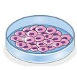

Drug Development
Discovery
Clinical trials
In Vitro/In vivo
Phase 1
Phase II
Phase III

Slide 6
Phase 1 trial
Purpose | Description
Safety evaluation | Determine the appropriate dosing levels by identifying the maximum tolerated dose (MTD). This involves administering the drug at gradually increasing doses while closely monitoring patients for adverse effects.
Pharmacokinetics | Absorption, Distribution, Metabolism, and Excretion (ADME): Phase I studies investigate how the body absorbs, distributes, metabolizes, and excretes the drug. This informs optimal dosing schedules.
Pharmacodynamics | Understanding how the drug interacts at the cellular and molecular levels within the human body, including its effects on tumors.
Initial efficacy signals | Although Phase I trials focus primarily on safety, they may provide preliminary data regarding potential therapeutic benefits, such as tumor shrinkage or biomarker changes.

Slide 7
Phase I oncology trials
 | Non oncology | Oncology
Subjects | Healthy volunteers | Advanced stage cancer patients - not curable, progressed on available standard treatments.
Ethics | Wide dose-range that is generally well tolerated. No therapeutic benefit | Potentially toxic treatment (due to mode of action) Limit number of patients exposed to excessively toxic doses; and those treated at sub-therapeutic doses
Design | Placebo controlled | Non controlled, small, sequential dose-escalation assignment
Treatment | Single dose (SAD) or repeat doses (MAD) | Repeat doses until disease progression
Primary Objectives | Short term safety and tolerability PK | Short term safety and tolerability (during first cycle) Identify Maximum Tolerated Dose (MTD) and Recommended dose regimen for further testing (RPIID)
Secondary | PD | PK/PD Clinical activity
Duration | Generally fast | Slow accrual, precise patient selection, and staggered entry

Slide 8
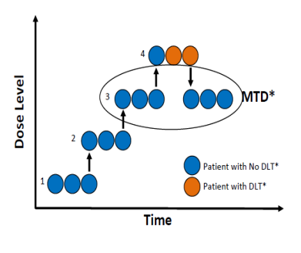
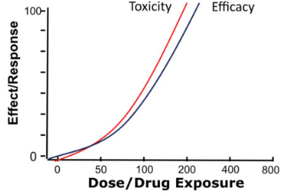
Maximum tolerated dose - MTD
Traditionally, it is aimed to find the maximum tolerated dose under the assumption that toxicity and efficacy increase with an increase in dose. Dose limiting toxicity (DLT) is observed within a defined window, typically 1 or 2 cycles of treatment. A treatment cycle is defined by the project team.
Notes:
Anti-cancer drugs with cytotoxic, highly immunosuppressive or immunogenic mecahnisms of action are typically associated with non neligible risk of toxicity
Oncology trials have included patients with advanced, unresectable tumors for which no curative treatment option exists and that have progressed beyond standard of care treatments
Trials are typically not placebo controlled, single arm, open-label, starting at subtherapeutic doses, with multiple dose escalation cohorts
An important consideration for phase I trials in patients is to avoid unnecessary exposure to subtherapeutic doses while preserving safety and maintaining rapid escalation to a therapeutic dose range.
The focus on DLT and MTD in FIH dose escalation trials reflects the empirical observation that certain level of toxicity is inevitable or even necessary for the tumor-killing activities of non-specific cytotoxic agents, such as alkylating agent or specific small molecular enzyme inhibitors, to manifest (Takimoto Citation2009). In the fast-paced early R&D cycle, therefore, the quickly emerging DLT can serve as semi-surrogate for potential efficacy signal which would otherwise take much longer to emerge. Once MTD is identified, a dose expansion cohort with larger sample size will be opened to further assess the safety and efficacy of the selected dose, leading to a Go/No-Go decision toward potential registrational path. Yet, 3 + 3 design lacks necessary statistical properties to identify the MTD dose with specific target DLT rate and often lead to early halt of dose escalation at non-efficacious level.

Slide 9
Dose recommendations
Dose escalation in phase I studies are broadly guided by three statistical recommendations
Escalate to a higher dose if no DLT observed
Stay/Remain if there is a minor safety concern
De-escalate or terminate if DLT is observed in multiple patients
Notes:
Anti-cancer drugs with cytotoxic, highly immunosuppressive or immunogenic mecahnisms of action are typically associated with non neligible risk of toxicity
Oncology trials have included patients with advanced, unresectable tumors for which no curative treatment option exists and that have progressed beyond standard of care treatments
Trials are typically not placebo controlled, single arm, open-label, starting at subtherapeutic doses, with multiple dose escalation cohorts
An important consideration for phase I trials in patients is to avoid unnecessary exposure to subtherapeutic doses while preserving safety and maintaining rapid escalation to a therapeutic dose range.
The focus on DLT and MTD in FIH dose escalation trials reflects the empirical observation that certain level of toxicity is inevitable or even necessary for the tumor-killing activities of non-specific cytotoxic agents, such as alkylating agent or specific small molecular enzyme inhibitors, to manifest (Takimoto Citation2009). In the fast-paced early R&D cycle, therefore, the quickly emerging DLT can serve as semi-surrogate for potential efficacy signal which would otherwise take much longer to emerge. Once MTD is identified, a dose expansion cohort with larger sample size will be opened to further assess the safety and efficacy of the selected dose, leading to a Go/No-Go decision toward potential registrational path. Yet, 3 + 3 design lacks necessary statistical properties to identify the MTD dose with specific target DLT rate and often lead to early halt of dose escalation at non-efficacious level.

Slide 10

Dose escalation methods
Rule-based
Model-based
Model-informed
3+3 design, rolling-six.
Targets observed toxicity rate of 33%
Simple but rigid, inefficient at finding the MTD
CRM, EWOC, BLRM
1 or 2 parameter model
Targets highest dose with Prob(DLT rate) <= Φ (typically 25-30%)
Next dose is dose with highest posterior probability of being near the target
BOIN, mTPI, mTPI-2
simplicity of algorithmic designs with efficiency of model-based designs
Targets highest dose with Prob(DLT)<= Φ( typically 25-30%)
Decision can be pre-tabulated

Slide 11
3+3 Design
A 3+3 design is a deterministic rule-based design. It is known to be a rigid and inefficient, with least statistically desirable operating characteristics
Enter 3 patients at lowest dose level
0 DLT
1 DLT
2-3 DLT
Escalate to next dose level
Enter 3 more at same dose level
Stop
MTD=Previous dose level
1 of 6 DLT
>1 of 6 DLT
Enter 3 patients at lowest dose level

Slide 12
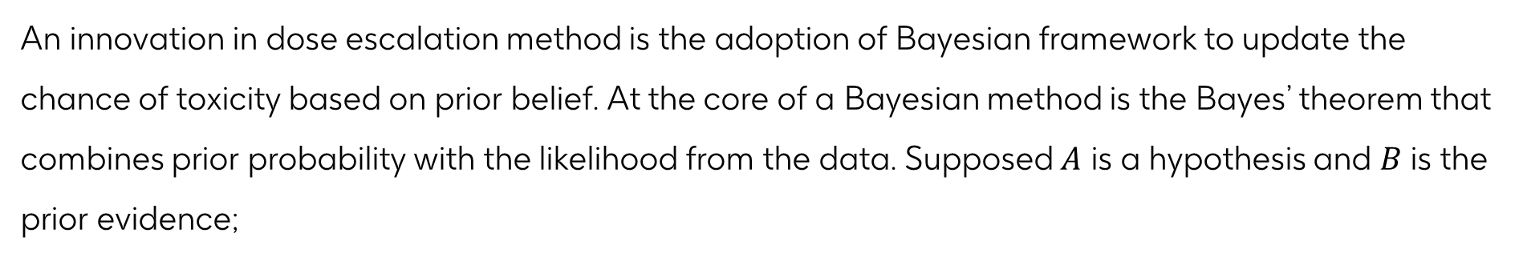

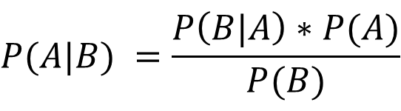
Bayes’ Theorem
An innovation in dose escalation method is the adoption of Bayesian framework to update the chance of toxicity based on prior belief. At the core of a Bayesian method is the Bayes’ theorem that combines prior probability with the likelihood from the data. Supposed $A$ is a hypothesis and $B$ is the prior evidence;
$$P(A|B) =\frac{P\left(B|A\right)∗P(A)}{P(B)}$$
The prior probability of the hypothesis - $P(A)$
The likelihood of observing the evidence given the hypothesis - $P\left(B|A\right)$
The prior probability of the evidence - $P(B)$

Slide 13
Posterior Probability
Posterior
Data
Prior belief
Question
What is the probability that one patient out of 6 will experience a DLT given the prior belief of 5% chance of toxicity?

Slide 14
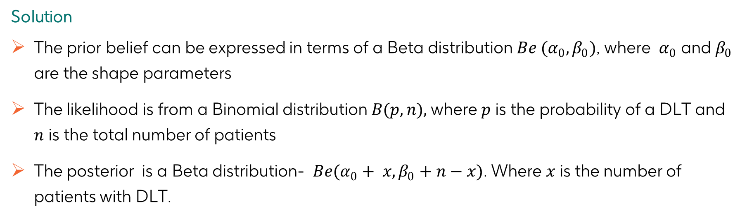
Posterior Probability
Posterior
Data
Prior belief
Solution
The prior belief can be expressed in terms of a Beta distribution $Be (α_{0},β_{0})$, where $α_{0}$ and $β_{0}$ are the shape parameters
The likelihood is from a Binomial distribution $B(p,n),$where $p$ is the probability of a DLT and $n$ is the total number of patients
The posterior is a Beta distribution- $Be(α_{0}+ x, β_{0}+n−x)$. Where $x$ is the number of patients with DLT.

Slide 15
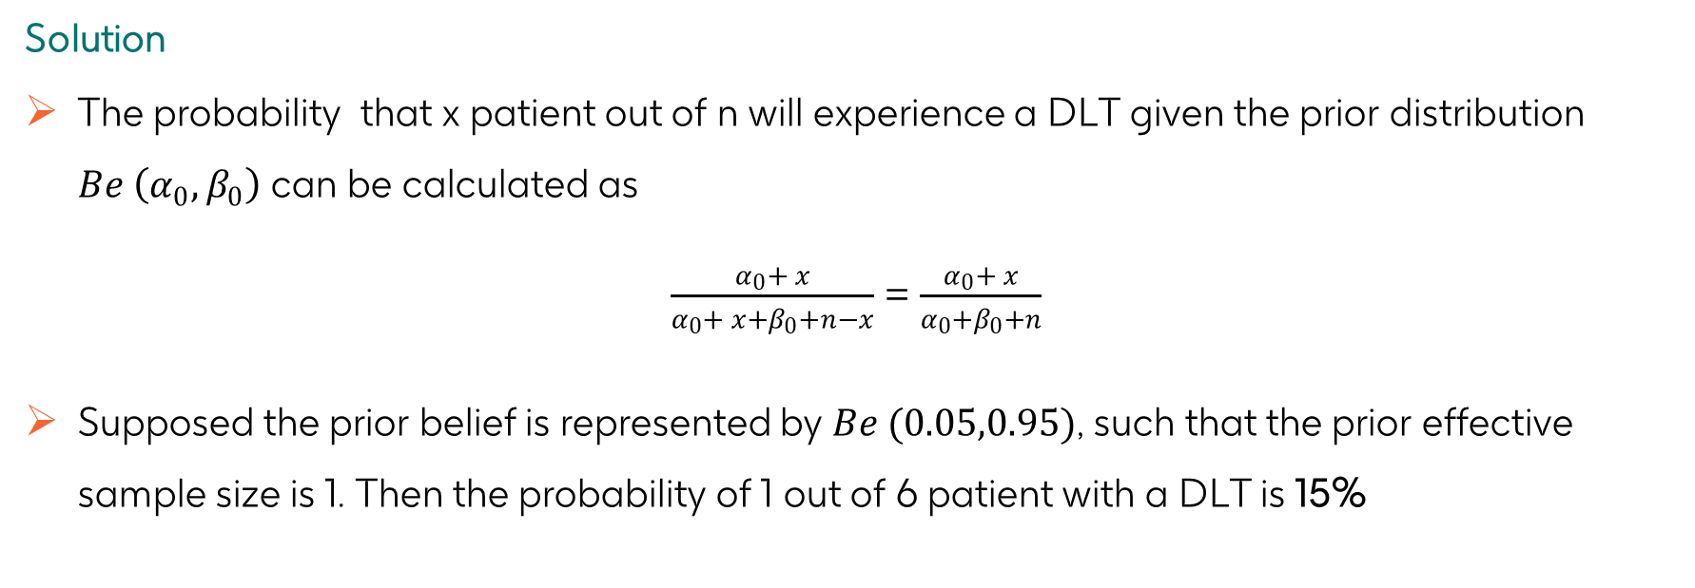
Prior & Posterior Probabilities
Posterior
Data
Prior belief
Solution
The probability that x patient out of n will experience a DLT given the prior distribution $Be \left(α_{0},β_{0}\right)$ can be calculated as
$\frac{α_{0}+ x}{α_{0}+ x+β_{0}+n−x}$ = $\frac{α_{0}+ x}{α_{0}+β_{0}+n}$
Supposed the prior belief is represented by $Be (0.05,0.95)$, such that the prior effective sample size is 1. Then the probability of 1 out of 6 patient with a DLT is 15%

Slide 16
Exercise 1
Posterior
Data
Prior belief
Question
Assuming the prior belief of 15% toxicity that is defined by Be(0.15,0.85), what is the probability that 1 out of 3 patients would have a DLT?

Slide 17
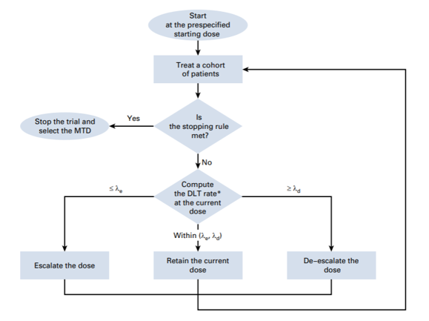
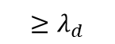
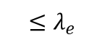
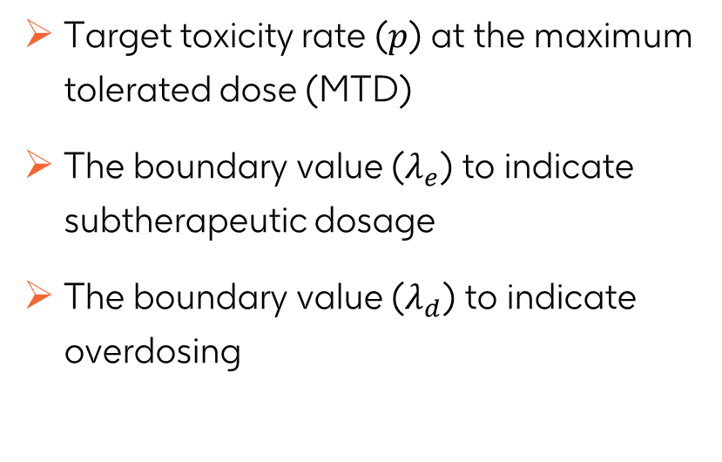
Bayesian Optimal Interval Design - BOIN
There are several Bayesian methods for dose-escalation studies, including the Bayesian Logistic regression model (BLRM). In this course, we would focus on BOIN method.
Target toxicity rate ($p$) at the maximum tolerated dose (MTD)
The boundary value ($λ_{e}$) to indicate subtherapeutic dosage
The boundary value ($λ_{d}$) to indicate overdosing
$${≤λ}_{e}$$
$${≥λ}_{d}$$

Slide 18
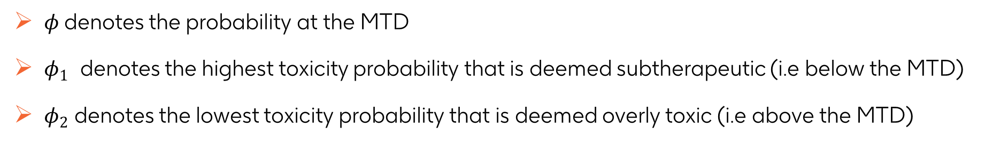
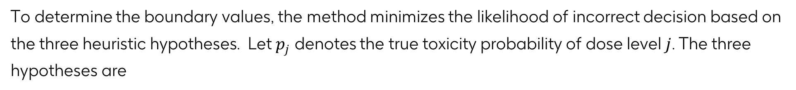
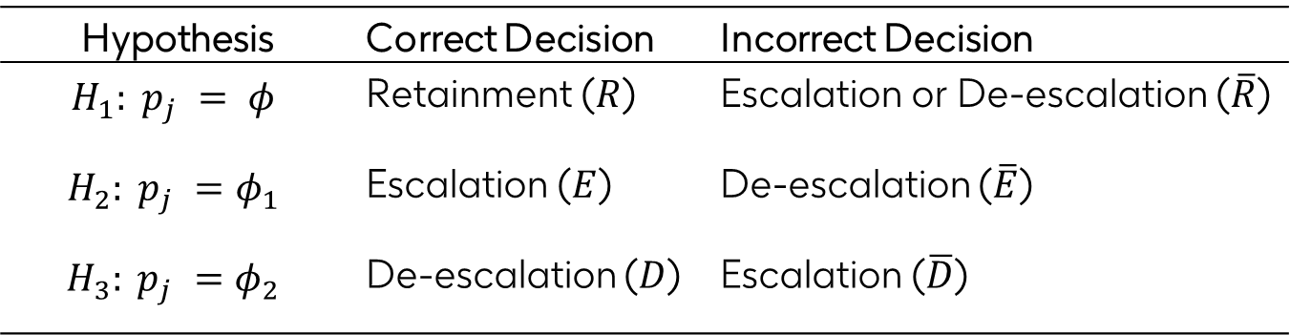
Bayesian Optimal Interval Design - BOIN
To determine the boundary values, the method minimizes the likelihood of incorrect decision based on the three heuristic hypotheses. Let $p_{j}$ denotes the true toxicity probability of dose level$j$. The three hypotheses are
Hypothesis | Correct Decision | Incorrect Decision
$$H_{1}: p_{j} = φ$$ | Retainment ($R$) | Escalation or De-escalation ($\overline{R}$)
$$H_{2}: p_{j} =φ_{1}$$ | Escalation ($E$) | De-escalation ($\overline{E}$)
$$H_{3}: p_{j} =φ_{2}$$ | De-escalation ($D$) | Escalation ($\overline{D}$)
$φ$denotes the probability at the MTD
$φ_{1}$ denotes the highest toxicity probability that is deemed subtherapeutic (i.e below the MTD)
$φ_{2}$ denotes the lowest toxicity probability that is deemed overly toxic (i.e above the MTD)

Slide 19
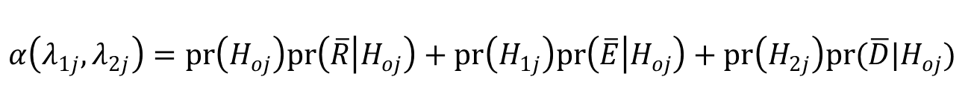
Bayesian Optimal Interval Design - BOIN
Let the probability of making an incorrect decision (the decision error rate), denoted as $α\left(λ_{1j},λ_{2j}\right)$. Determine the values of $λ_{1j}$ and $λ_{2j}$ that minimize the probability of incorrect decision.
$$α\left(λ_{1j},λ_{2j}\right)=pr\left(H_{oj}\right)pr\left(\overline{R} | H_{oj}\right)+pr\left(H_{1j}\right)pr\left(\overline{E} | H_{oj}\right)+pr\left(H_{2j}\right)pr(\overline{D}|H_{oj})$$
$$pr\left(\overline{R} | H_{oj}\right)=pr\left(m_{j}<n_{j}λ_{1j}\right)+pr(m_{j}>n_{j}λ_{2j})$$
$$pr\left(\overline{R} | H_{oj}\right)=B\left(n_{j}λ_{1j};n_{j},φ\right)+1− B(n_{j}λ_{2j}−1;n_{j},φ)$$
$B(b;n, φ)$ is cumulative density function of the binomial distribution with size $n$ and probability $φ$, evaluated the value $b$

Slide 20
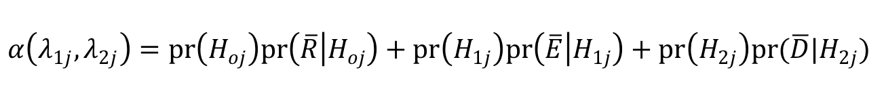
Bayesian Optimal Interval Design - BOIN
Similarly,
$$α\left(λ_{1j},λ_{2j}\right)=pr\left(H_{oj}\right)pr\left(\overline{R} | H_{oj}\right)+pr\left(H_{1j}\right)pr\left(\overline{E} | H_{1j}\right)+pr\left(H_{2j}\right)pr(\overline{D}|H_{2j})$$
$$pr\left(\overline{E} | H_{1j}\right)=1− B(n_{j}λ_{1j}−1;n_{j},φ_{1})$$
$$pr(\overline{D}|H_{2j})= B(n_{j}λ_{2j}−1;n_{j},φ_{2})$$
$pr\left(H_{oj}\right)$, $pr\left(H_{1j}\right)$ and $pr\left(H_{2j}\right)$ are equal prior probabilities i.e non informative priors

Slide 21


Bayesian Optimal Interval Design - BOIN
The decision error is minimum when,
$$λ_{ij}=log\frac{1−φ_{1}}{1−φ}/log\frac{φ(1−φ_{1})}{φ_{1}(1−φ)}$$
$$λ_{2j}=log\frac{1−φ}{1−φ_{2}}/log\frac{φ_{2}(1−φ)}{ φ(1−φ_{2})}$$

Slide 22
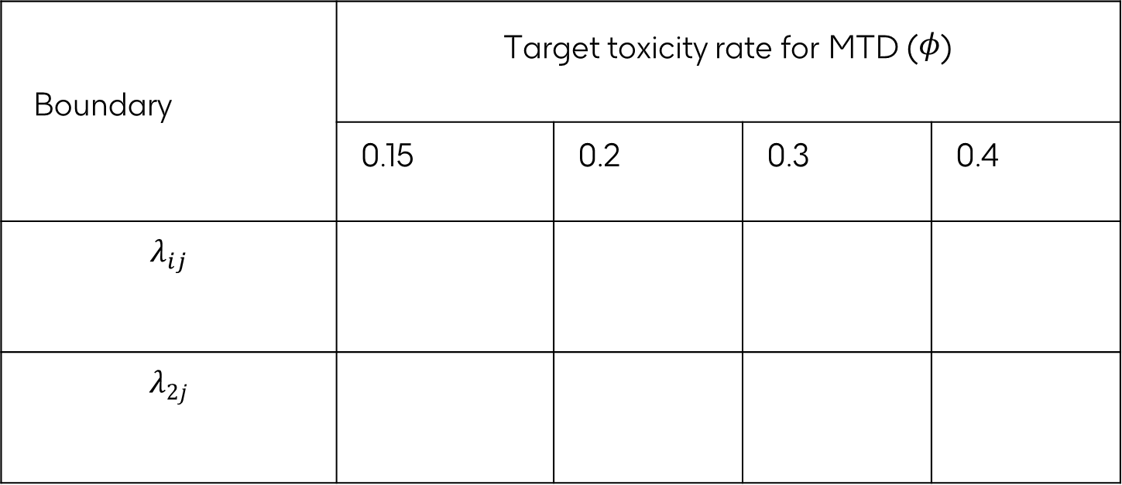
Exercise 2
Complete the table below assuming $φ_{1}=0.6φ$ and $φ_{2}=1.2φ$
Boundary | Target toxicity rate for MTD ($φ$)
 | 0.15 | 0.2 | 0.3 | 0.4
$$λ_{ij}$$
$$λ_{2j}$$

Slide 23
Generalisation
Boundary values obtained under the non-informative priors are invariant to dose levels
Practical implementations require that the boundary values are independent of dose levels and can be pre-tabulated.
The generalisation from dose levels specific boundary values require formulating composite hypothesis and working with a Beta distribution instead of binomial distribution
For further reading about BOIN method and its generalization, read Liu S and Yuan Y paper Bayesian optimal interval designs for phase I clinical trials. J R Stat Soc Ser C Appl Stat 2015;64:507–23.

Slide 24
Case Study
LOAd703, an oncolytic virus-based immunostimulatory gene therapy, combined with chemotherapy for unresectable or metastatic pancreatic cancer (LOKON001): results from arm 1 of a non-randomised, single-centre, phase 1/2 study
- Musher et al (2024)

Slide 25
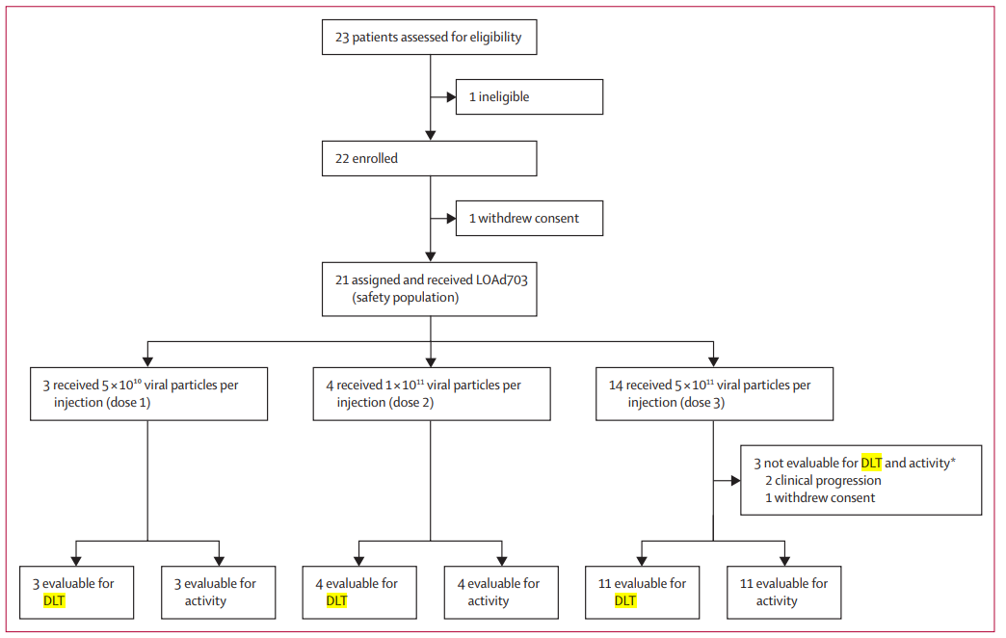
Case Study
Study conducted between Dec 2, 2016, and Oct 17, 2019

Slide 26
Case Study
Use BOIN method to determine the MTD dose for a hypothetical phase I trial of LOAd703 based on the following assumptions and DLT data
Assumptions
3 Dose Levels; Dose 1, Dose2 and 3
3, 4, and 11 patients per dose, respectively
Targeted toxicity rate of 30% at MTD

Slide 27
Case Study
Use BOIN method to determine the MTD dose for a hypothetical phase I trial of LOAd703 based on the following assumptions and DLT data
DLT Data: number of patients with DLT per cohort
 | Dose 1 | Dose 2 | Dose 3
 | Cohort 1 N=3 | Cohort 2 N=4 | Cohort 3 N=3 | Cohort 4 N=3 | Cohort 5 N=3 | Cohort 6 N=2
Scenario 1 | 0 | 0 | 0 | 1 | 0 | 0
Scenario 2 | 0 | 1 | 0 | 1 | 1 | 1
Scenario 3 | 0 | 1 | 1 | 0 | 1 | 1

Slide 28
Case Study
# Load necessary library
if (!require(BOIN)) { install.packages("BOIN")}
library(BOIN)
#Get Boundary
bound <- get.boundary(target=0.3, ncohort=18, cohortsize=3)

Slide 29
Case Study
Pre-tabulated decision table.
Number of patients treated | 1 | 2 | 3 | 4 | 5 | 6 | 7 | 8 | 9 | 10 | 11 | 12 | 13 | 14 | 15 | 16 | 17 | 18
Escalate if # of DLT <= | 0 | 0 | 0 | 0 | 1 | 1 | 1 | 1 | 2 | 2 | 2 | 2 | 3 | 3 | 3 | 3 | 4 | 4
Deescalate if # of DLT >= | 1 | 1 | 2 | 2 | 2 | 3 | 3 | 3 | 4 | 4 | 4 | 5 | 5 | 6 | 6 | 6 | 7 | 7
Eliminate if # of DLT >= | NA | NA | 3 | 3 | 4 | 4 | 5 | 5 | 5 | 6 | 6 | 7 | 7 | 8 | 8 | 8 | 9 | 9
The boundary values the error functions are $λ_{1}$=0.236 and $λ_{2}$= 0.359

Slide 30
Scenario 1
Dose recommendation under scenario 1
DLT
Escalate
No DLT
Escalate
MTD = Dose 3
Dose 1
Dose 2
Dose 3

Slide 31
Scenario 1
## create data
patients <- c(3, 4,11) ## number of patients per dose
dlt <- c(0, 0,1) ## number of dlt per dose
## determine the MTD
selmtd <- select.mtd(target=0.3, npts=patients, ntox=dlt)
> summary(selmtd)
The MTD is dose level 3
Dose Posterior DLT 95%
Level Estimate Credible Interval Pr(toxicity>0.3|data)
1 0.01 (0.00,0.16) 0.01
2 0.01 (0.00,0.16) 0.01
3 0.09 (0.00,0.31) 0.03
NOTE: no estimate is provided for the doses at which no patient was treated.

Slide 32
Exercise 3
Determine the MTD for scenario 2 & 3 and provide justification for your dose recommendation.
DLT Data: number of patients with DLT per cohort
 | Dose 1 | Dose 2 | Dose 3
 | Cohort 1 N=3 | Cohort 2 N=4 | Cohort 3 N=3 | Cohort 4 N=3 | Cohort 5 N=3 | Cohort 6 N=2
Scenario 2 | 0 | 1 | 0 | 1 | 1 | 1
Scenario 3 | 0 | 1 | 1 | 0 | 1 | 1

Slide 33
Operating characteristics
We have assumed until now that a dose-escalation study has been conducted and the DLT data is available for analysis. However, Statisticians mostly rely on simulation studies to inform study design because data from the trial are not available at this stage.
Key Questions
Operating Characteristics
What is the total number of DLT and average DLT per dose?
How many patients allocated to the MTD?
What is the impact of starting dose?
…
What is the expected toxicity at MTD?
What are the like toxicity level per dose?
How many patient is needed?

Slide 34
Operating characteristics
Design a hypothetical dose escalation study assuming 20% target toxicity at MTD , a total sample size of 36 patients with 3 patients per cohort and different starting dose levels (Dose 1, Dose 2 and Dose 3). Derive the operating characteristic with and without early stopping after 9 patient has been assigned to the MTD.
The true toxicity rate per dose are:
Dose 1 | Dose 2 | Dose 3 | Dose 4 | Dose 5
0.02 | 0.05 | 0.08 | 0.1 | 0.15

Slide 35
Scenario 1: Starting Dose = Dose 1
Simulation Set up
Simulation Code
target = 0.25 # target toxicity at MTD
p.true = c(0.02,0.05,0.08,0.1,0.15) # True toxicity level per dose
ncohort = 12 # total number of cohorts
cohortsize = 3 ## number of patients per cohort
Startdose =1 # starting dose
Ntrial =1000 ## number of simulated trials
seed=6 ## simulation seed to ensure reproducibility
scen1_Dose1 <- get.oc(target, p.true, ncohort, cohortsize, startdose, ntrial=1000, seed=6)

Slide 36
Scenario 1: Starting Dose = Dose 1
Results
$ simu.setup :'data.frame': 5 obs. of 12 variables:
..$ target : num [1:5] 0.25 0.25 0.25 0.25 0.25
..$ p.true : num [1:5] 0.02 0.05 0.08 0.1 0.15
..$ ncohort : num [1:5] 12 12 12 12 12
..$ cohortsize: num [1:5] 3 3 3 3 3
..$ startdose : num [1:5] 1 1 1 1 1
..$ p.saf : num [1:5] 0.15 0.15 0.15 0.15 0.15
..$ p.tox : num [1:5] 0.35 0.35 0.35 0.35 0.35
..$ cutoff.eli: num [1:5] 0.95 0.95 0.95 0.95 0.95
..$ extrasafe : logi [1:5] FALSE FALSE FALSE FALSE FALSE
..$ offset : num [1:5] 0.05 0.05 0.05 0.05 0.05
..$ ntrial : num [1:5] 1000 1000 1000 1000 1000
..$ dose : int [1:5] 1 2 3 4 5
$ selpercent : num [1:5] 0.1 0.5 2.4 9.7 87.3
$ npatients : num [1:5] 3.74 4.58 5.39 6.59 15.7
$ ntox : num [1:5] 0.071 0.221 0.405 0.632 2.381
$ totaltox : num 3.71
$ totaln : num 36
$ percentstop: num 0
$ flowchart : logi TRUE
$ lambda_e : num 0.197
$ lambda_d : num 0.298
- attr(*, "class")= chr "boin"

Slide 37
Scenario 1: Starting Dose = Dose 1
Operating Characteristics
Dose | Target | P.True | selpercent | #patients | #tox
1 | 0.25 | 0.02 | 0.1 | 3.738 | 0.071
2 | 0.25 | 0.05 | 0.5 | 4.578 | 0.221
3 | 0.25 | 0.08 | 2.4 | 5.388 | 0.405
4 | 0.25 | 0.1 | 9.7 | 6.594 | 0.632
5 | 0.25 | 0.15 | 87.3 | 15.702 | 2.381
The most selected dose as MTD is Dose 5
Only 44% of the patients were treated at MTD
56% of the patients were treated at a sub-therapeutic dose
Average toxicity is about 4 out of 36

Slide 38
Scenario 1: Starting Dose = Dose 2
Operating Characteristics
Simulation Set up
Dose | Target | P.True | selpercent | #patients | #tox
1 | 0.25 | 0.02 | 0 | 0.495 | 0.009
2 | 0.25 | 0.05 | 0.2 | 4.629 | 0.213
3 | 0.25 | 0.08 | 2.2 | 5.616 | 0.446
4 | 0.25 | 0.1 | 8.9 | 6.912 | 0.695
5 | 0.25 | 0.15 | 88.7 | 18.348 | 2.757
target = 0.25 # target toxicity at MTD
p.true = c(0.02,0.05,0.08,0.1,0.15) # True toxicity level per dose
ncohort = 12 # total number of cohorts
cohortsize = 3 ## number of patients per cohort
Startdose =2 # starting dose
Ntrial =1000 ## number of simulated trials
seed=6 ## simulation seed to ensure reproducibility
The most selected dose as MTD is Dose 5
Only 50% of the patients were treated at MTD
50 % of the patients were treated at a sub-therapeutic dose
Dose 1 – Dose were selected as MTD < 1%
Average toxicity is about 4 out of 36

Slide 39
Scenario 1: Starting Dose = Dose 3
Operating Characteristics
Simulation Set up
Dose | Target | P.True | selpercent | #patients | #tox
1 | 0.25 | 0.02 | 0 | 0.135 | 0.006
2 | 0.25 | 0.05 | 0.3 | 1.101 | 0.055
3 | 0.25 | 0.08 | 1.5 | 5.658 | 0.435
4 | 0.25 | 0.1 | 7.4 | 7.167 | 0.715
5 | 0.25 | 0.15 | 90.8 | 21.939 | 3.264
target = 0.25 # target toxicity at MTD
p.true = c(0.02,0.05,0.08,0.1,0.15) # True toxicity level per dose
ncohort = 12 # total number of cohorts
cohortsize = 3 ## number of patients per cohort
Startdose =2 # starting dose
Ntrial =1000 ## number of simulated trials
seed=6 ## simulation seed to ensure reproducibility
The most selected dose as MTD is Dose 5
Only 58% of the patients were treated at MTD
42 % of the patients were treated at a sub-therapeutic dose
Dose 1 – Dose were selected as MTD < 1%
Average toxicity is about 4.5 out of 36

Slide 40
Scenario 1: Impact of Early Stopping
The previous design assigned most patients to Dose 5, which may be desirable since it provides more data on the potential recommended Phase 2 dose (RP2D). However, it takes longer to completed the study.
To move faster and to reduce cost, early stopping may be consider to stop dose-escalation after a fixed number of patients have administered the same dose.
Starting Dose = 2 with an early stopping of 9 patients
Starting Dose = 3 with an early stopping of 9 patients
Dose | Target | P.True | selpercent | #patients | #tox
1 | 0.25 | 0.02 | 0.2 | 0.549 | 0.014
2 | 0.25 | 0.05 | 3.8 | 4.425 | 0.215
3 | 0.25 | 0.08 | 8.5 | 4.839 | 0.409
4 | 0.25 | 0.1 | 12.3 | 5.649 | 0.531
5 | 0.25 | 0.15 | 75.2 | 7.455 | 1.147
Dose | Target | P.True | selpercent | #patients | #tox
1 | 0.25 | 0.02 | 0.2 | 0.144 | 0.007
2 | 0.25 | 0.05 | 1.2 | 1.113 | 0.063
3 | 0.25 | 0.08 | 8.4 | 4.974 | 0.401
4 | 0.25 | 0.1 | 11.7 | 5.679 | 0.557
5 | 0.25 | 0.15 | 78.5 | 7.734 | 1.13

Slide 41
Group work 1
Design a hypothetical dose escalation study assuming 20% target toxicity at MTD , a total sample size of 36 patients with 3 patients per cohort and different starting dose (Dose 1, Dose 2 and Dose 3). Derive the operating characteristic for your design with and without early stopping after 9 patient has been assign to the MTD.
Scenario | Dose 1 | Dose 2 | Dose 3 | Dose 4 | Dose 5
1 | 0.10 | 0.2 | 0.25 | 0.30 | 0.35
2 | 0.05 | 0.10 | 0.20 | 0.35 | 0.30
3 | 0.25 | 0.30 | 0.35 | 0.40 | 0.35

Slide 42
Beyond MTD

Slide 43
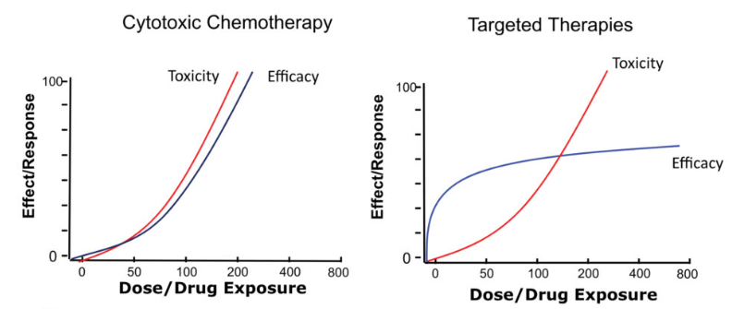
Phase I – Molecular Targeted Agents & Immunotherapies
Is “more” always better?

Slide 44
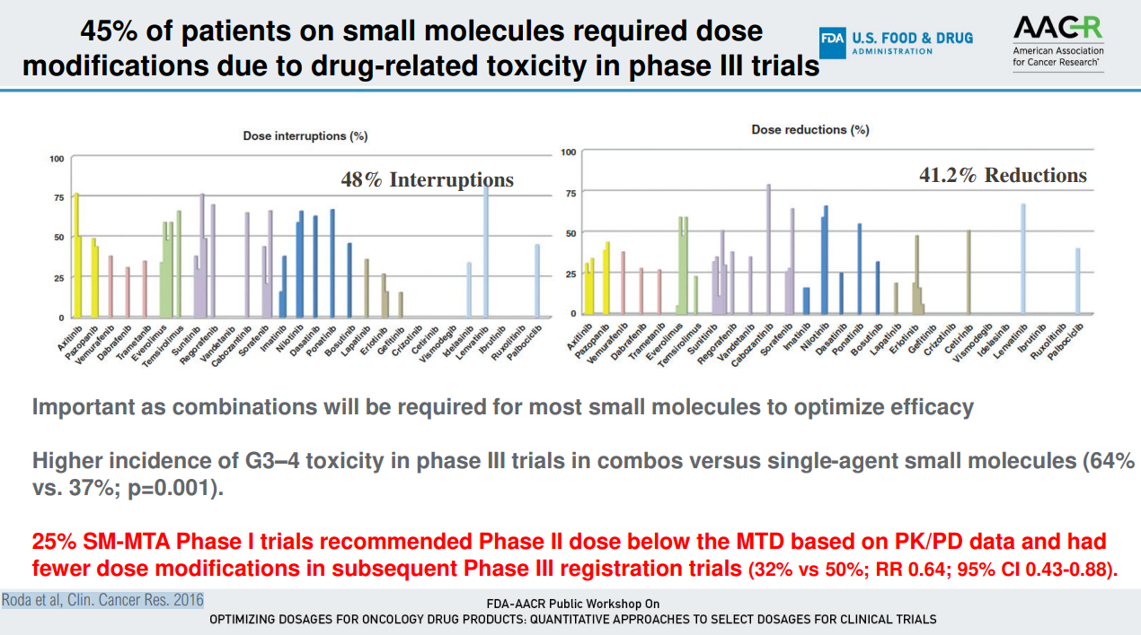

Slide 45
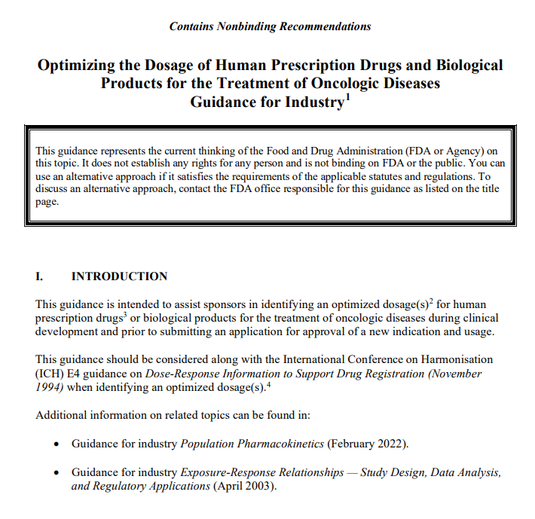
FDA’s Project optimus: Reform dose optimisation for oncology
Sort out dosing designs before approval
Characterize human biological dosage (preclinical dose-exposure relationship)
Understand and characterize the dose-response relationship for toxicity and for activity
Consider all data beyond DLT to identify a target dose range of interest (overall toxicity profile over prolonged period of time, efficacy data short & long term, PROs, Modelling etc.. )
Conduct randomized dose-optimisation (DO) trials with min 2 doses to confirm efficacy and safety at well informed doses (phase II)
Identify "optimal dose" for further study
(indication specific / combination specific)
Optimizing the Dosage of Human Prescription Drugs and Biological Products for the Treatment of Oncologic Diseases

Slide 46
Approaches to seamless phase I/II designs
Sequential seamless phase I/IIa design
Integrated seamless phase I/IIa design
DE guided by Safety
Aims at MTD
DE guided by safety & activity to identify OBD
DL5
DL5
Use all data to Select doses for DO
DL4
Use all data to select doses for DO
DL4
DL3
DL3
DL2
DL2
DL1
Backfilling / Dose expansions at safe doses to identify OBD
DL1
(Extra backfilling may also be used)

Slide 47
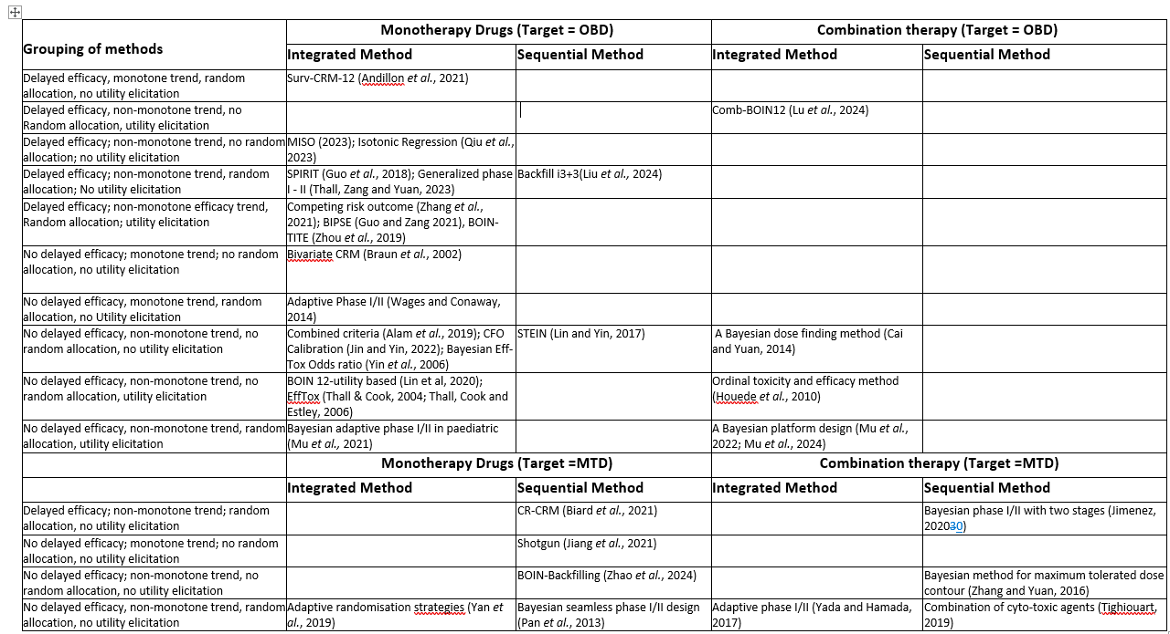

Slide 48
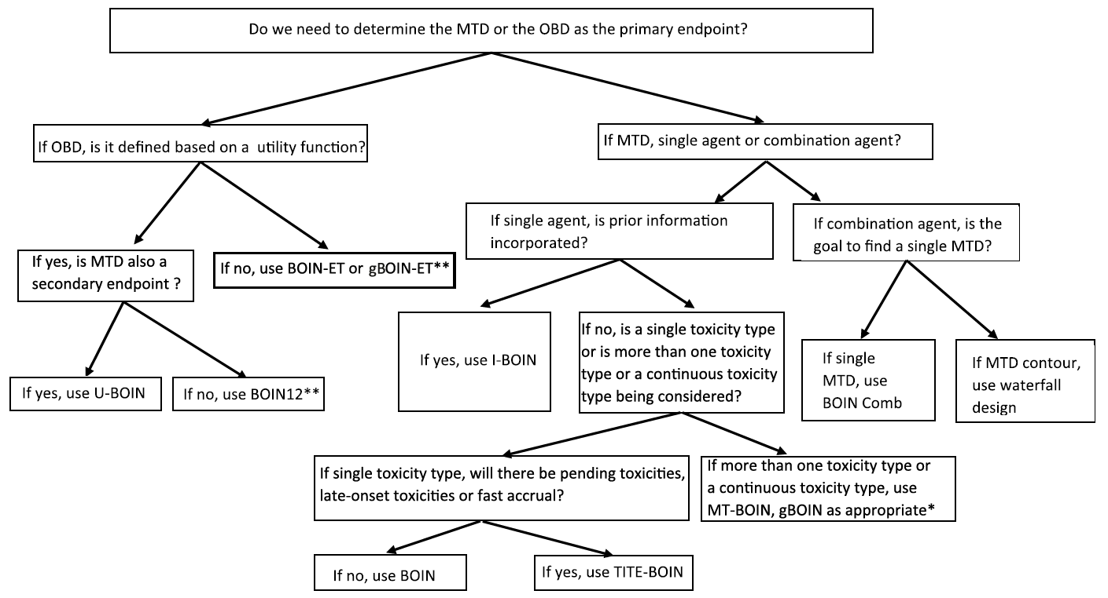
BOIN Suite of Algorithms
Notes:
Both publications from Dept of hematology univeristy of Beijing – would be intersting to see if those doing CART in companies used this

Slide 49
Phase 2 Trials

Slide 50
Objective and Learning Outcomes
Objective
Introduce Multiple Comparison Procedure – Modelling method
Dose-response analysis using MCP-Mod
Learning Outcomes
Understand the rationale for MCP-Mod
Able to use DoseFinding Package in R
Analysis and interpretation of results

Slide 51
Phase 2 trials
Discovery
Clinical trials
In Vitro/In vivo
Phase 1
Phase II
Phase III

Slide 52
Phase 2 trials
Purpose | Description
Efficacy Assessment | Determine whether the drug exhibits a biological effect in patients. Unlike Phase 1 trials that focus primarily on safety, Phase 2 trials aim to demonstrate the drug's activity against cancer.
Dose Optimization | Identify the dose that provides the best balance between efficacy and toxicity
Safety and Toxicity Profiling | Continue to monitor adverse effects, understanding the safety profile more thoroughly in a larger patient population compared to Phase 1
Biomarker Identification | Identify and validate biomarkers that predict response, resistance, or risk.
Proof of Concept | Provide initial evidence that the drug is effective for a specific cancer type or subtype.

Slide 53
Phase 2A vs Phase 2 B
Exploratory
Establish Phase 3 dose & schedule
Early efficacy sign
Confirmation of efficacy sign
Safety and Tolerability
Long-term endpoint
Phase 2A
Phase 2B
Short-term endpoint
Advanced safety profiling
Smaller sample size
Bigger sample size

Slide 54
Common efficacy endpoints in Phase 2
Overall Response Rate (ORR)
The proportion of patients whose cancer shrinks or disappears after treatment.
Components:
Complete Response (CR): Total disappearance of all target lesions.
Partial Response (PR): At least a 30% decrease in the diameter of target lesions.
Usage: ORR serves as a direct measure of a drug’s anti-tumor activity and is frequently used as a primary endpoint in Phase 2 trials.
Note: ORR is part of RECISTS outcome categories including Stable Disease (SD) and Progressive Disease (PD)

Slide 55
Common efficacy endpoints in Phase 2
Progression-Free Survival (PFS)
The duration during which a patient's cancer does not worsen after treatment. It is a time-to-event endpoint
Measurement:
Time from the start of treatment until disease progression or death.
Usage: It is a more informative endpoint than ORR and it is acceptable as a regulatory endpoint in some cancer types like ovarian cancer.

Slide 56
Other endpoints
Overall Survival (OS): Time from the start of treatment until death from any cause.
Time to Progression (TTP): Time from the start of treatment to the point where cancer growth is first observed.
Disease Control Rate (DCR): The total percentage of patients who achieve a complete response, partial response, or stable disease.
Biomarker-focused Endpoints: Evaluating biomarker changes as indicators of cancer drug effects
Quality of Life (QoL): Evaluating changes in patients' overall well-being, using standardized questionnaires.

Slide 57
PICOS Framework
A good way to gain insights into published clinical trials is using PICOS framework that focuses on the following key features;
P - Population
I - Intervention
C - Comparison
O - Outcome
S – Study design
What is the population of patients included in the clinical trial?
What is the investigational medicinal product evaluated in the trial?
What comparator or standard of care used to evaluate clinical benefit?
What is the study design including allocation method and sample size?
What are the endpoints used in the trial and their results?
Notes:
t primary analysis, 267 patients received treatment across seven tumor cohorts: endometrial, cervical, ovarian, bladder, biliary tract, pancreatic, and other.

Slide 58
Exercise 4
What are the key design features of the Phase II clinical trial of pembrolizumab efficacy and safety in advanced adrenocortical carcinoma – Habra et al. (2019). The paper is available in the course folder
What are the limitation and the strength of the study design?
Notes:
t primary analysis, 267 patients received treatment across seven tumor cohorts: endometrial, cervical, ovarian, bladder, biliary tract, pancreatic, and other.

Slide 59
Exercise 5
What are the key design features of the clinical trial of Dostarlimab or pembrolizumab plus chemotherapy in previously untreated metastatic non-squamous non-small cell lung cancer: the randomized PERLA phase II trial – Lim et al. (2023). The paper is available in the course folder
What are the limitation and the strength of the study design?
Notes:
t primary analysis, 267 patients received treatment across seven tumor cohorts: endometrial, cervical, ovarian, bladder, biliary tract, pancreatic, and other.

Slide 60
Phase II Study Design Methods
Design | Description
Single-Arm Trials | Participants receive the experimental treatment without a control group. This design is often used when the historical outcomes can serve as a comparison, or in cases where ethical considerations prevent withholding treatment.
Randomized Controlled Trials (RCTs): | Participants are randomly assigned to either the experimental or control group, allowing more reliable efficacy and safety comparisons with or without blinding
Adaptive Designs | Allows adaptations like sample size adjustment, dose escalation/de-escalation, and treatment arm additions/removals
Basket Trials | Focuses on patient cohorts across various cancer types sharing a common trait, expanding the scope of investigation
Umbrella Trials | Patients within a single type of cancer are divided into groups, each testing different therapies or combinations.
Platform Trials | Utilizes a master protocol and allows testing of different interventions over time against a common control.
Notes:
t primary analysis, 267 patients received treatment across seven tumor cohorts: endometrial, cervical, ovarian, bladder, biliary tract, pancreatic, and other.

Slide 61
MCP-Mod

Slide 62
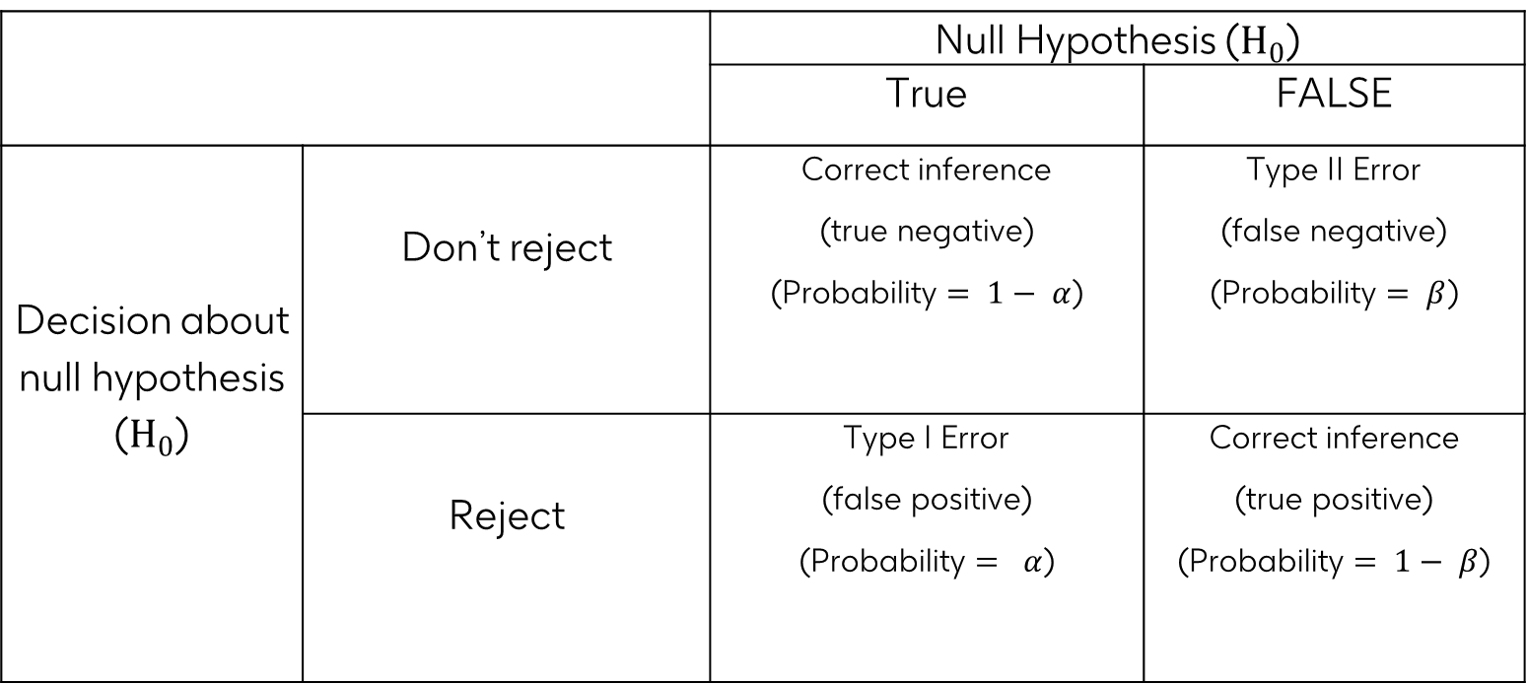
Introduction of MCP-Mod
 |  | Null Hypothesis ($H_{0}$)
 |  | True | FALSE
Decision about null hypothesis ($H_{0}$) | Don’t reject | Correct inference (true negative) (Probability $= 1− α$) | Type II Error (false negative) (Probability $= β$)
 | Reject | Type I Error (false positive) (Probability $= α$) | Correct inference (true positive) (Probability $= 1− β$)
To make correct statistical decision about whether a drug work or not, we need to balance between the Type I Error and Type II Error. Statistical power of a test is 1 – Type II Error.

Slide 63
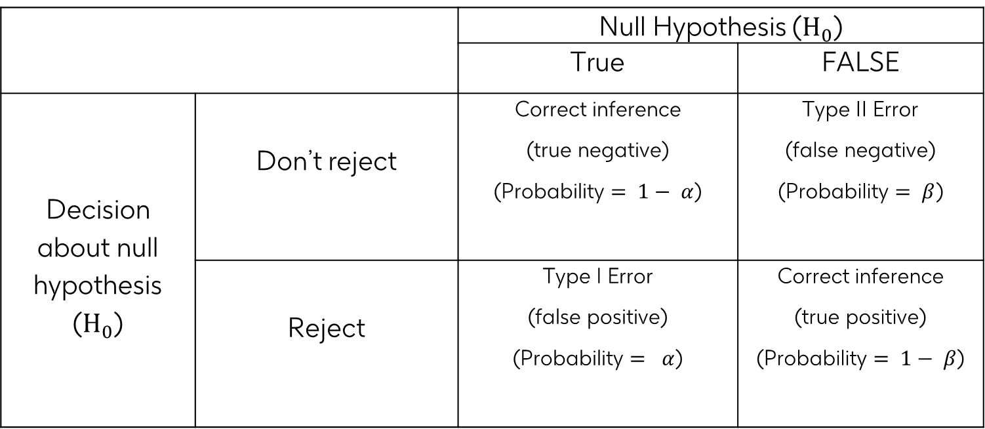

Introduction of MCP-Mod
 |  | Null Hypothesis ($H_{0}$)
 |  | True | FALSE
Decision about null hypothesis ($H_{0}$) | Don’t reject | Correct inference (true negative) (Probability $= 1− α$) | Type II Error (false negative) (Probability $= β$)
 | Reject | Type I Error (false positive) (Probability $= α$) | Correct inference (true positive) (Probability $= 1− β$)
For a single hypothesis tested, there is $α$ chance of a false conclusion, which increases with increase in the number of hypothesis tests. Specifically;
$$FWER={1− (1−α)}^{K}$$

Slide 64
Exercise 5
What is the family wise error rate for testing 3, 5 and 10 hypotheses at alpha level of 5%?

Slide 65
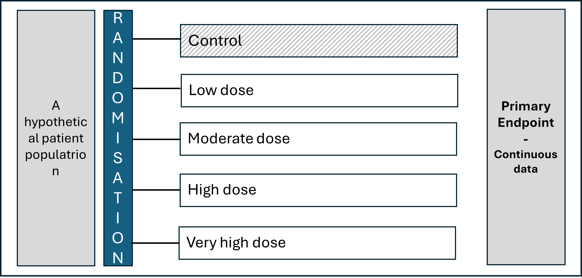
Introduction of MCP-Mod
Assuming all doses are safe, which dose is the most effective dose?

Slide 66
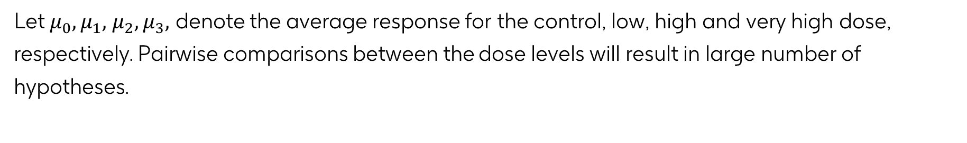
Hypothesis testing
Let $μ_{0},μ_{1},$ $μ_{2},μ_{3},$ denote the average response for the control, low, high and very high dose, respectively. Pairwise comparisons between the dose levels will result in large number of hypotheses.
To preserve the FWER, multiplicity correction is required using methods including Tukey test, Bonferroni, Benjamini and Hochberg FDR, etc
Alternatively, each of the active doses can be compared with the control dose and multiplicity correction can be done using the Dunnett test

Slide 67
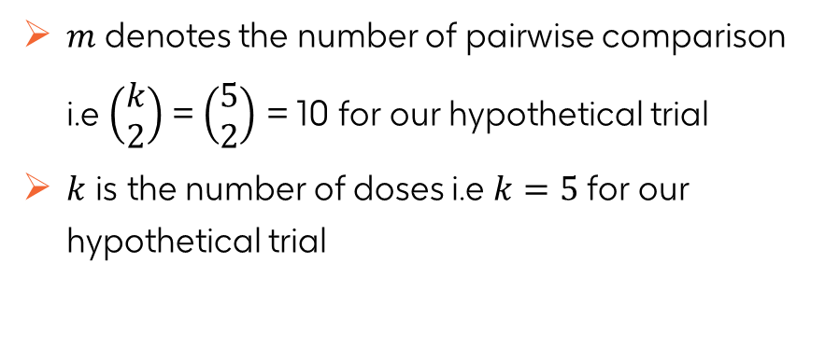
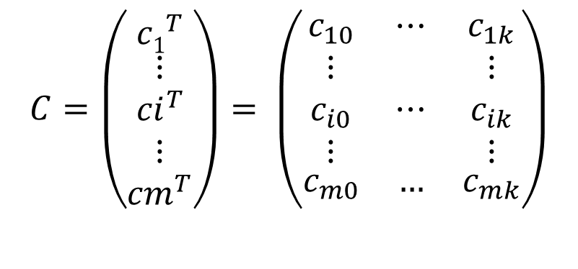
Hypothesis testing
The null hypothesis can be formulated in terms of contrasts between the dose levels.
$$H_{0}: c^{T}μ=0$$
Where $c$ defines the contrast of interests.
$$C=\left(\begin{matrix}{c1}^{T} \\ \begin{matrix}⋮ \\ {ci}^{T} \\ ⋮\end{matrix} \\ {cm}^{T}\end{matrix}\right)= \left(\begin{matrix}c_{10} & ⋯ & c_{1k} \\ \begin{matrix}⋮ \\ c_{i0} \\ ⋮\end{matrix} & ⋯ & \begin{matrix}⋮ \\ c_{ik} \\ ⋮\end{matrix} \\ c_{m0} & … & c_{mk}\end{matrix}\right)$$
$m$ denotes the number of pairwise comparison i.e $\left(\begin{matrix}k \\ 2\end{matrix}\right)$ = $\left(\begin{matrix}5 \\ 2\end{matrix}\right)$ = 10 for our hypothetical trial
$k$ is the number of doses i.e $k=5$for our hypothetical trial

Slide 68
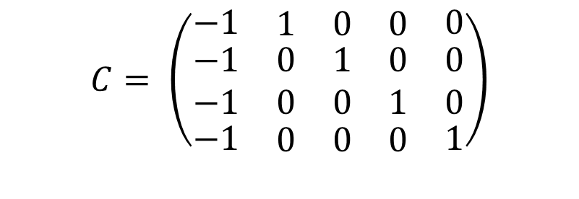
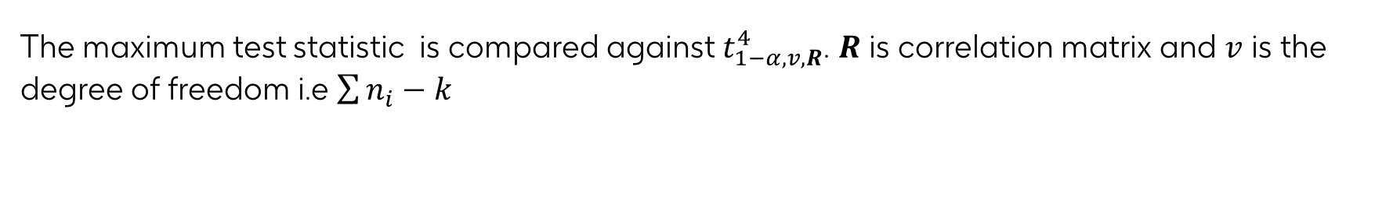
Hypothesis testing
The null hypothesis can be formulated in terms of contrasts between the dose levels.
$$H_{0}: c^{T}μ=0$$
For Dunnett Test
$$C= \left(\begin{matrix}−1 & \begin{matrix}1 & 0 & 0\end{matrix} & 0 \\ \begin{matrix}−1 \\ −1\end{matrix} & \begin{matrix}\begin{matrix}0 & 1 & 0\end{matrix} \\ \begin{matrix}0 & 0 & 1\end{matrix}\end{matrix} & \begin{matrix}0 \\ 0\end{matrix} \\ −1 & \begin{matrix}0 & 0 & 0\end{matrix} & 1\end{matrix}\right)$$
Number of tests reduces to 4 instead of 10 hypotheses.
The maximum test statistic is compared against $t_{1−α,v,R}^{4}$. $R$ is correlation matrix and $v$ is the degree of freedom i.e $\sum{n_{i}}−k$

Slide 69
Introduction of MCP-Mod
Traditionally, dose-finding studies often employed pairwise comparisons between doses and placebo or linear models to identify dose-response relationships. These methods are straightforward but can be inefficient and sometimes misleading when dealing with complex dose-response relationships.
As pharmaceutical development processes evolved, there was a clear need for methodologies that could intelligently and robustly model dose-response curves, handle multiple possible models, and incorporate statistical testing to ensure scientifically backed decisions.

Slide 70
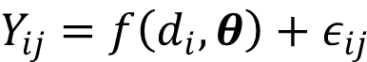
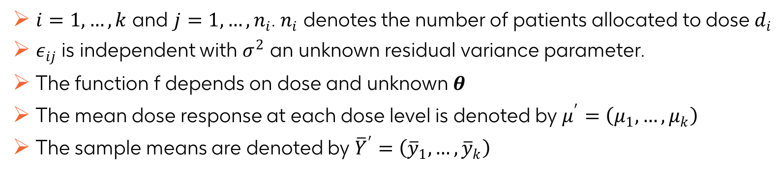
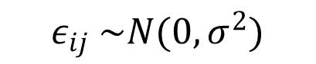
Introduction to MCP-Mod
Let $d_{1},…,d_{k}$ denotes the K doses in a trial with $d_{1}=0$ representing the control dose or standard of care. The responses of patients in the trial can be expressed as
$$Y_{ij}=f\left(d_{i},θ\right)+ε_{ij}$$
$$ε_{ij} \sim N(0,σ^{2})$$
$i=1,…,k$ and $j=1,…,n_{i}$. $n_{i}$ denotes the number of patients allocated to dose $d_{i}$
$ε_{ij}$ is independent with $σ^{2}$ an unknown residual variance parameter.
The function f depends on dose and unknown $θ$
The mean dose response at each dose level is denoted by $μ^{′}=\left(μ_{1},…,μ_{k}\right)$
The sample means are denoted by ${\overline{Y}}^{′}=$ $\left({\overline{y}}_{1},…,{\overline{y}}_{k}\right)$

Slide 71
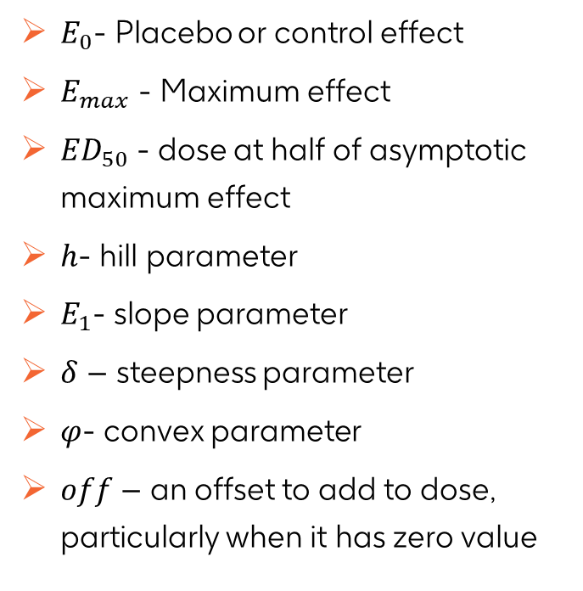
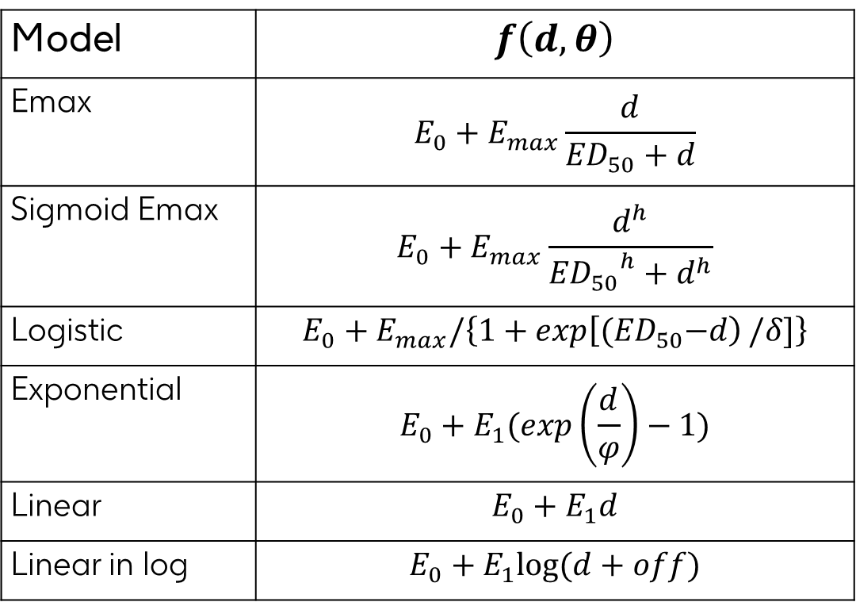
Candidate models
Model | $$f\left(d,θ\right)$$
Emax | $$E_{0}+E_{max}\frac{d}{{ED}_{50}+d}$$
Sigmoid Emax | $$E_{0}+E_{max}\frac{d^{h}}{{{ED}_{50}}^{h}+d^{h}}$$
Logistic | $$E_{0}+E_{max}/\left\{1+\exp\left[{(ED}_{50}−d\right)/δ]\right\}$$
Exponential | $$E_{0}+E_{1}(\exp\left(\frac{d}{φ}\right)−1)$$
Linear | $$E_{0}+E_{1}d$$
Linear in log | $$E_{0}+E_{1}log(d+off)$$
$E_{0}$- Placebo or control effect
$E_{max}$ - Maximum effect
${ED}_{50}$ - dose at half of asymptotic maximum effect
$h$- hill parameter
$E_{1}$- slope parameter
$δ$ – steepness parameter
$φ$- convex parameter
$off$ – an offset to add to dose, particularly when it has zero value

Slide 72
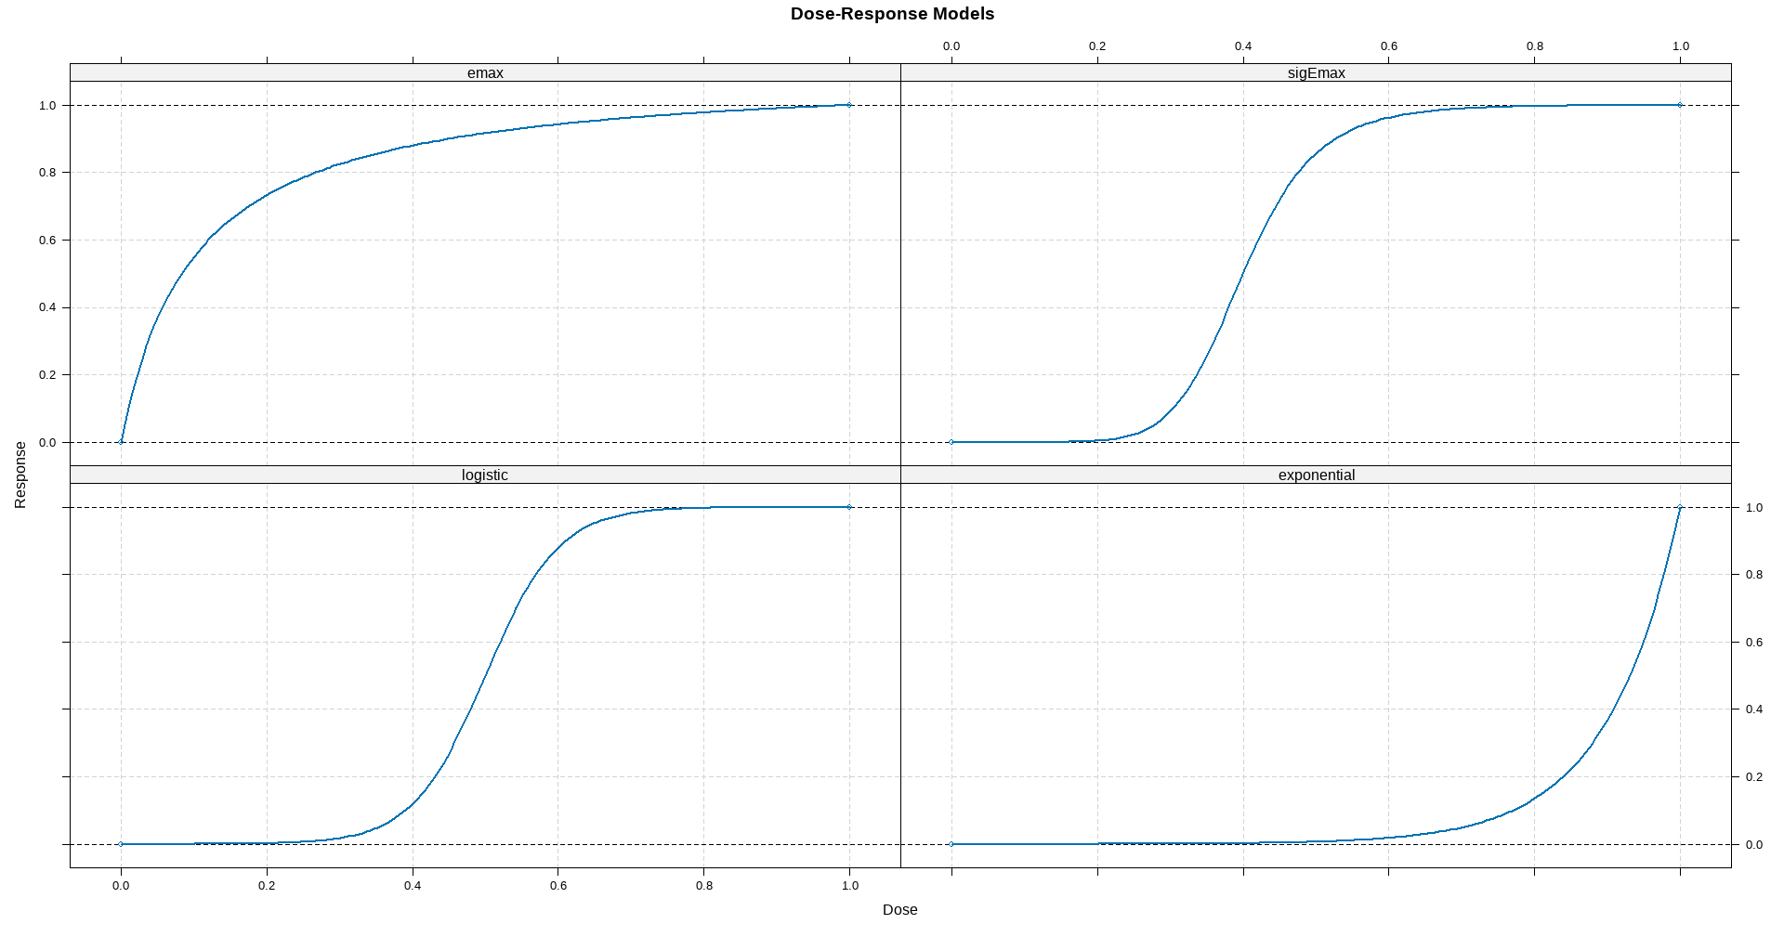
Candidate Models

Slide 73
MCP-Mod steps
Define M Candidates models
MCP
Define Optimal Contrast per model
No Significant Model
Perform hypothesis testing & adjust for multiplicity
STOP
Retain models with significant result
Mod
Select the best model among the significant models
Estimate model parameters

Slide 74
Dose response analysis: Continuous Endpoint
(Examples are based on non-oncology studies)

Slide 75
Introduction to MCP-Mod
Let $d_{1},…,d_{k}$ denotes the K doses in a trial with $d_{1}=0$ representing the control dose or standard of care. The responses of patients in the trial can be expressed as
$$Y_{ij}=f\left(d_{i},θ\right)+ε_{ij}$$
$$ε_{ij} \sim N(0,σ^{2})$$
$i=1,…,k$ and $j=1,…,n_{i}$. $n_{i}$ denotes the number of patients allocated to dose $d_{i}$
$ε_{ij}$ is independent with $σ^{2}$ an unknown residual variance parameter.
The function f depends on dose and unknown $θ$
The mean dose response at each dose level is denoted by $μ^{′}=\left(μ_{1},…,μ_{k}\right)$
The sample means are denoted by ${\overline{Y}}^{′}=$ $\left({\overline{y}}_{1},…,{\overline{y}}_{k}\right)$

Slide 76
Data – simulated data
Safety and efficacy data on Glycopyrronium Bromide (NVA237) in patients with stable Chronic Obstructive Pulmonary Disease (COPD). The primary endpoint in this study was the mean of two measurements of forced expiratory volume in 1 second (FEV1) at 23h 15min and 23h 45min post dosing, following 7 days of treatment. The doses of interest are placebo group and the four dose groups (12.5, 25, 50, and 100μg).

Slide 77
Data

Slide 78
Candidate models
What are the likely candidate models?

Slide 79
Hypothesis testing
Assuming four candidate models, emax1, emax2, sigEmax and quadratic. The null hypothesis for equal average response across doses can be formulated as
$$H_{0}: c^{T}\overline{Y}=0$$
The contrast matrix is defined per model and can be obtained using the following
# define doses and models
doses <- c(0, 12.5, 25, 50, 100)
mods <- Mods(emax = c(2.6, 12.5), sigEmax = c(30.5, 3.5), quadratic = -0.00776, placEff = 1.25, maxEff = 0.15, doses = doses)
optC <- optContr(mods, w=1)
print(optC)
Doses emax1 emax2 sigEmax quadratic
0 -0.886 -0.813 -0.486 -0.723
12.5 0.116 -0.101 -0.439 -0.240
25 0.211 0.136 -0.120 0.140
50 0.265 0.326 0.448 0.587
100 0.294 0.452 0.597 0.236
Contrast for each model must sum to zero

Slide 80
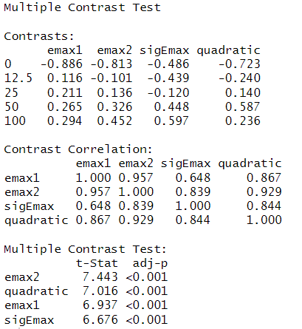
Hypothesis testing
MCTtest function in DoseFinding package performs the multiple comparison procedure
fitlm <- lm(FEV1 ~ factor(dose) - 1, data = NVA)
mu_hat <- coef(fitlm)
S_hat <- vcov(fitlm)
anova_df <- fitlm$df.residual
test_general <- MCTtest(dose = doses, resp = mu_hat, S = S_hat, df = anova_df, models = mods, type = "general")
All the candidate models resulted in significant results, but which model to selected for estimating MED?

Slide 81
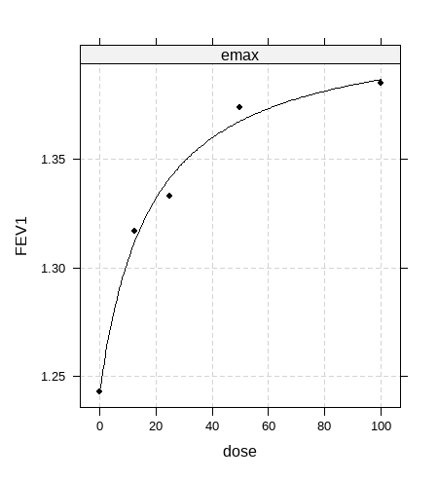
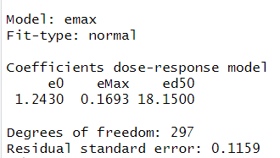
Non-linear models
Fit Emax model to the data.
fit_single <- fitMod(dose, FEV1, NVA, model = "emax")
plot(fit_single)

Slide 82
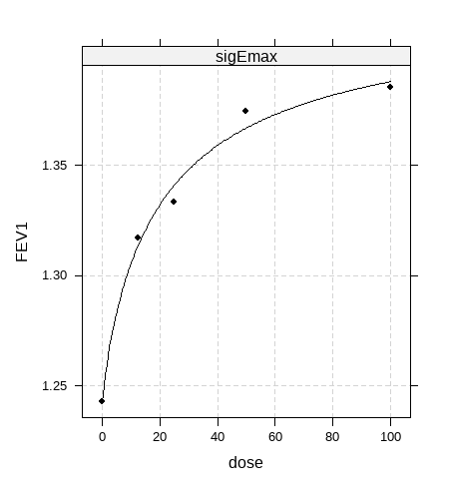
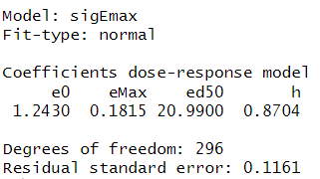
Non-linear models
Fit Sigmoid Emax model to the data.
fit_single <- fitMod(dose, FEV1, NVA, model = "sigEmax")
plot(fit_single)

Slide 83
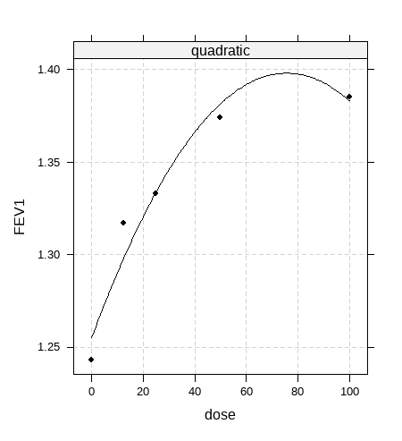
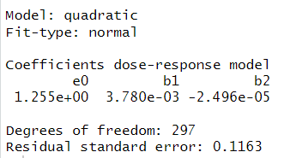
Non-linear models
Fit Quadratic model to the data.
fit_single <- fitMod(dose, FEV1, NVA, model = “quadratic")
plot(fit_single)

Slide 84
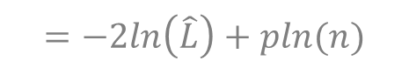

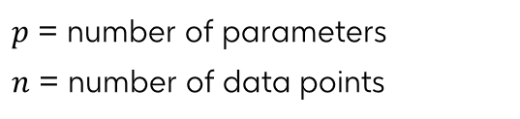
Model selection
The best model can be selected using
The model with the largest t-statistics
Akaike Information Criterion – AIC. Smaller value is better
Bayesian Information Criterion – BIC. Smaller value is better
Model | AIC Value
Emax | -436.5819
Sigmoid Emax | -434.6034
Quadratic | -434.7099
$$=−2ln\left(\hat{L}\right)+2$$
$$=−2ln\left(\hat{L}\right)+pln(n)$$
$p$ = number of parameters
$n$ = number of data points
Which model is the best model?

Slide 85
Group Work 2
Analyse the dose response data “DoseRespDataCont.csv” to determine if there is a dose-response relationship between PD marker (Response) and dose , and if there is, what dose is necessary to achieve 50% response using the PD marker?

Slide 86
Dose response analysis: Binary Endpoint
(Examples include a non-oncology study)

Slide 87
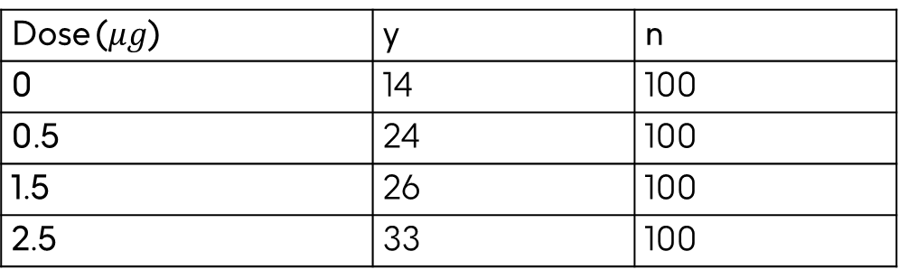
Data
Assume a dose-finding study is planned for a hypothetical investigational treatment in atopic dermatitis, for the binary endpoint Investigator’s Global Assessment (IGA). The treatment is tested with doses 0, 0.5, 1.5, 2.5, 4. It is assumed the response rate for placebo will be around 10%, while the response rate for the top dose may be 35%. This is an example where the generalized MCP-Mod approach can be applied, i.e. dose-response testing and estimation will be performed on the logit scale.
Dose ($μg$) | y | n
0 | 14 | 100
0.5 | 24 | 100
1.5 | 26 | 100
2.5 | 33 | 100
This lesson uses simulated data

Slide 88
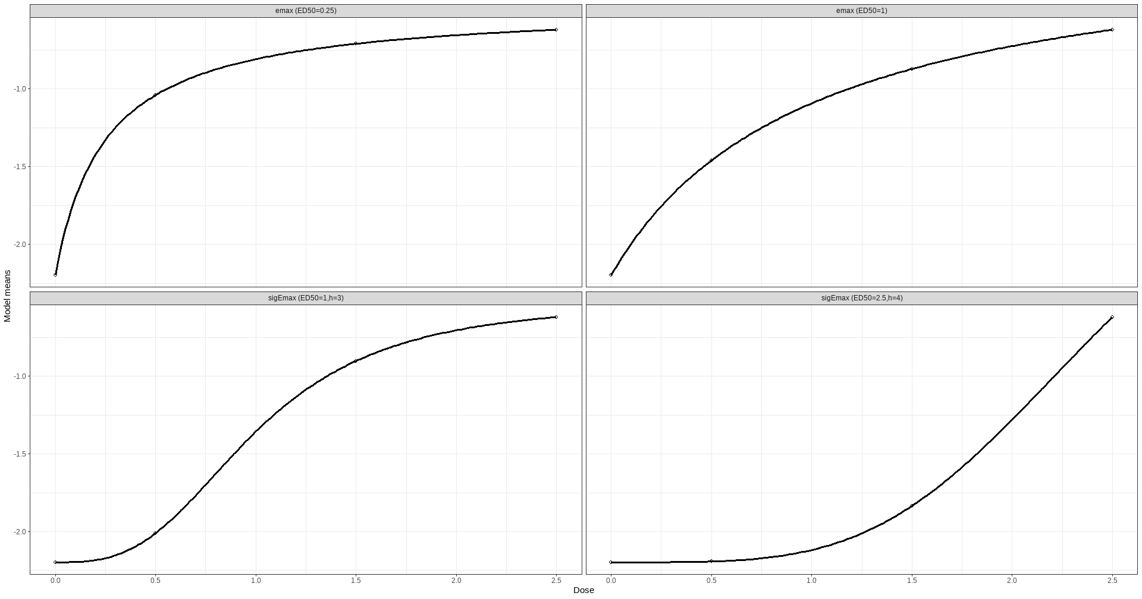
Candidate models

Slide 89
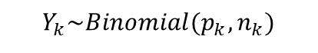

Hypothesis Testing
The binary response can be analysed using a generalized linear model with binomial distribution and a logit link
$$Y_{k}\sim Binomial(p_{k},n_{k})$$
$$logit\left(p_{k}\right)\sim β_{k}$$
$$H_{0}: c^{T}\overline{β}=0$$
# define doses and models
logit <- function(p) log(p / (1 - p))inv_logit <- function(y) 1 / (1 + exp(-y))
doses <- c(0, 0.5, 1.5, 2.5)
mods <- Mods(emax = c(0.25, 1), sigEmax = rbind(c(1, 3), c(2.5, 4)), placEff = logit(0.1), maxEff = logit(0.35)- logit(0.1),doses = doses)
optC <- optContr(mods, w=1)
print(optC)
Dose emax1 emax2 sigEmax1 sigEmax2
0 -0.839 -0.749 -0.561 -0.376
0.5 0.081 -0.143 -0.424 -0.372
1.5 0.343 0.342 0.389 -0.096
2.5 0.415 0.550 0.596 0.843
Contrast for each model must sum to zero

Slide 90
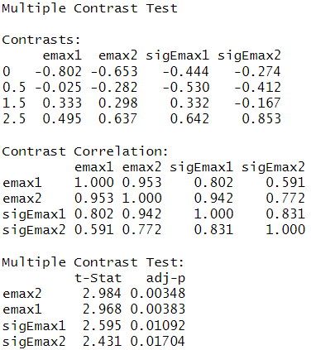
Hypothesis testing
fit_nocov <- glm(Response~factor(Dose) + 0, data = binData, family = binomial)
mu_hat <- coef(fit_nocov)
S_hat <- vcov(fit_nocov)
MCTtest(doses, mu_hat, S = S_hat, models = mods, type = "general")
All the candidate models resulted in significant results, but which model is the best model?

Slide 91


Non-linear models
Fit Emax model to the data.
fit_Emax <- fitMod(doses, mu_hat, S = S_hat, model = "emax")
plot(fit_Emax)

Slide 92


Non-linear models
Fit Sigmoid Emax model to the data.
fit_sigEmax <- fitMod(doses, mu_hat, S = S_hat, model = "emax")
plot(fit_sigEmax)

Slide 93

Model selection
The best model can be selected using
The model with the largest t-statistics
Akaike Information Criterion – AIC. Smaller value is better
Bayesian Information Criterion – BIC. Smaller value is better
Model | AIC Values
Emax | 0.048
Sigmoid Emax | 0.617
$$=−2ln\left(\hat{L}\right)+2$$
$$=−2ln\left(\hat{L}\right)+pln(n)$$
$p$ = number of parameters
$n$ = number of data points
Which model is the best model?

Slide 94
Group Work 3
Analyse the dose response data “DoseRespDataBin.csv” to determine if there is a dose-response relationship between PD marker (Response) and dose , and if there is, what dose is necessary to achieve 50% response using the PD marker?

Slide 95
Dose response analysis using Bayesian variable selection method
SYMSTAT 2025
Adetayo Kasim

Slide 96
Outline
Introduction
Bayesian Approach
Case Study
Questions

Slide 97
Introduction
Dose-response studies within OMICs have similar features as the traditional dose response studies. However;
Thousands of genes/protein/peptides are measured under increasing dose of a compound.
No known function relationship between response and dose
Number of dose is usually small.
The main objective is to evaluate if the expression of a gene is dose-dependent

Slide 98
Case Study
HESCA : Human epidermal squamous carcinoma cell lines
 | EGF (ng/ml)
Dose | 0 | 1 | 10 | 100
# of arrays | 3 | 3 | 3 | 3
4 dose levels.
12 arrays.
16,998 genes measured per array
A dose-response microarray oncology experiment designed to better understand the biological effects of growth factors in human tumor.
(Bijnens et al., 2012)
Method can be applied to any omics platform with appropriate adjustment

Slide 99
Case Study
Gene 4910
Gene 3350
Gene 3680
These three genes are selected for illustration only

Slide 100


Case Study
Randomised controlled trial containing four active dose group and a place group
Dose | 0 | 0.05 | 0.20 | 0.60 | 1
# of arrays | 20 | 20 | 20 | 20 | 20
PoC decision criteria
$$P\left(g_{o} | Data\right)<0.05$$

Slide 101
Method
Let $d_{1},…,d_{k}$ denotes the K doses in a trial with $d_{1}=0$ representing the control dose or standard of care. The responses of patients in the trial can be expressed as
$$Y_{ij}=f\left(d_{i},θ\right)+ε_{ij}$$
$$ε_{ij} \sim N(0,σ^{2})$$
$i=1,…,k$ and $j=1,…,n_{i}$. $n_{i}$ denotes the number of patients allocated to dose $d_{i}$
$ε_{ij}$ is independent with $σ^{2}$ an unknown residual variance parameter.
The function f depends on dose and unknown $θ$
The mean dose response at each dose level is denoted by $μ^{′}=\left(μ_{1},…,μ_{k}\right)$
The sample means are denoted by ${\overline{Y}}^{′}=$ $\left({\overline{y}}_{1},…,{\overline{y}}_{k}\right)$

Slide 102
Methods
Pairwise comparisons
No assumption required about the nature of the dose-response relationship
Inference restricted to the set of dose under investigation and multiplicity correction is required
Model-based approach
Assumes a functional relationship between response and dose
Requires set of candidate parametric models, mostly non-linear models
Model selection
To determine the best model for estimating minimum effective dose.
(Bretz et al. 2005, Lin et al. 2012)

Slide 103


Frequentist approach
Assuming unknown functional form, dose-response data can be analysed using One-way ANOVA under simple order restrictions.
$$Y_{ij}=N(μ_{i},σ^{2})$$
Where dosed-specific means ($μ_{i}$) are constrained to be monotone
$$μ_{0}≤μ_{1}≤⋯≤μ_{K}$$
$i =0,…,K−1$denotes dose and $j = 1, …, n_{i}$denotes observation per dose. $K$ is the number of dose.

Slide 104


Frequentist approach
Establishing dose-response signal reduces to testing two hypothesis
$H_{0}: μ_{0}=μ_{1}$= $μ_{2}$=…= $μ_{K}$
versus
$H_{a}: μ_{0}{≤μ}_{1}$ $≤ μ_{2} ≤$… $≤$ $μ_{K}$
With at least one strict inequality.

Slide 105
Frequentist approach
Isotonic Regression
The average response per dose constrained to be monotone using Pool Adjacent Violator Algorithm (PAVA, Robertson et al., 1988 )
Likelihood Ratio Test (Barlow, 1972)
Compare unconstrained and order restricted trends based on isotonic means
Multiple Contrast Test (MCT: Murkerjee et al., 1987)
Compare active dose and control dose using contrast tests (Williams 1971, 1972; Marcus 1976)

Slide 106



Frequentist approach
Model selection approach to simultaneously establish dose-response relationship and to determine the minimum effect dose (MED)
All possible models
$$\begin{matrix}g_{0}:μ_{0}=μ_{1}=μ_{2}=μ_{3} \\ g_{1}:μ_{0}=μ_{1}=μ_{2}<μ_{3} \\ g_{2}:μ_{0}=μ_{1}<μ_{2}=μ_{3} \\ g_{3}:μ_{0}<μ_{1}=μ_{2}=μ_{3} \\ g_{4}:μ_{0}<μ_{1}=μ_{2}<μ_{3} \\ g_{5}:μ_{0}=μ_{1}<μ_{2}<μ_{3} \\ g_{6}:μ_{0}<μ_{1}<μ_{2}=μ_{3} \\ \begin{aligned}&g_{7}:μ_{0}<μ_{1}<μ_{2}<μ_{3} \\ &\end{aligned}\end{matrix}$$
$H_{0}: μ_{0}=μ_{1}$= $μ_{2}$=…= $μ_{K}$
versus
$H_{a}: μ_{0}{≤μ}_{1}$ $≤ μ_{2} ≤$… $≤$ $μ_{K}$

Slide 107


Frequentist approach
$2^{K−1}$ candidate models under order restriction.
There are 8 possible models for K=4 assuming non-decreasing constraint

Slide 108

Frequentist approach
Burnham and Anderson (2002) to fit each of the candidate model and calculate posterior probability of the model given data as:
Information criteria (IC)
AIC: Akaike information criterion
BIC: Bayesian information criterion
ORIC: Order restricted information criteria
$$P\left(g_{i} | Data\right)=\frac{P\left(Data | g_{i}\right)P(g_{i})}{\sum_{r=1}^{R}{P\left(Data | g_{r}\right)P(g_{r})}} i=0,…,K−1$$
Where
$P\left(Data | g_{r}\right)=e^{−∆{IC}_{i}}$ and $∆{IC}_{i}={IC}_{i}−min⁡({IC}_{1},…,{IC}_{K−1})$

Slide 109
Bayesian approach
Our main motivation for considering Bayesian approach is to estimate posterior probability for each model under order restriction and to provide framework to simultaneously establish dose-response relationship, dose-response profile and estimate the minimum effective dose
However, there is no direct way to draw posterior samples from order restricted space without strict inequality constraint between parameters.

Slide 110



Bayesian approach
Likelihood
Prior
$$Y_{ij}=N(μ_{i},σ^{2})$$
$$μ_{i}=N\left(ɳ_{μ},σ_{μ}^{2}\right)I(μ_{i−1},μ_{i+1})$$
(Gelfand and Kuo, 1991)
Gelfan and Kuo (1991) approach cannot be directly applied when $μ_{i−1}=μ_{i+1 }$
Dunson & Nelson (2003) proposed Bayesian isotonic regression.
Kato and Hoijtink (2006) proposed using encompassing priors.

Slide 111



Bayesian approach
Dose-response data can be analysed using mixture model with constrained priors. For illustration purpose, let’s assume K= 2. A control dose and an active dose.
$$μ_{1}=μ_{0}+δ_{1}$$
$$y_{i}|μ_{0},δ_{1},σ^{2}=wN\left(μ_{0}+δ_{1},σ^{2}\right)+(1−w)wN\left(μ_{0},σ^{2}\right)$$
$$μ_{1}=μ_{0}$$
$μ_{1}=μ_{0}+δ_{1}$ and $δ_{1}>0.$
$μ_{0} \sim N(0,σ_{1}^{2})$ and $δ_{1} \sim N\left(0,σ_{1}^{2}\right)I(0,)$
$σ^{−2}\sim IG(0.0001, 0.0001$ and $σ_{1}^{−2}\sim IG(0.0001, 0.0001)$
Kasim et al. (2012)

Slide 112





Bayesian approach
The mixture model can be formulated as a Bayesian variable selection model
$$y_{i}|μ_{0},δ_{1},σ^{2}=N\left(μ_{0}+z∗δ_{1},σ^{2}\right)$$
Priors
$$μ_{0}\sim N(0,σ_{1}^{2})$$
$$z\sim Bern(p)$$
$$δ_{1}\sim N\left(0,σ_{1}^{2}\right)I(0,)$$
$$p\sim Unif(0,1)$$

Slide 113

Bayesian approach
Identifier ($G$=1+$\sum_{h=1}^{K−1}{z_{h}2^{h−1}}$) | Inclusion indicator ($z$) | Mean Structure | Model label
1 | $$z=(z_{1}=0,z_{2}=0,z_{3}=0)$$ | $$μ_{0}=μ_{1}=μ_{2}=μ_{3}$$ | $$g_{0}$$
2 | $$z=(z_{1}=1,z_{2}=0,z_{3}=0)$$ | $$μ_{0}=μ_{1}=μ_{2}<μ_{3}$$ | $$g_{1}$$
3 | $$z=(z_{1}=0,z_{2}=1,z_{3}=0)$$ | $$μ_{0}=μ_{1}<μ_{2}=μ_{3}$$ | $$g_{2}$$
4 | $$z=(z_{1}=1,z_{2}=1,z_{3}=0)$$ | $$μ_{0}<μ_{1}=μ_{2}=μ_{3}$$ | $$g_{3}$$
5 | $$z=(z_{1}=0,z_{2}=0,z_{3}=1)$$ | $$μ_{0}<μ_{1}=μ_{2}<μ_{3}$$ | $$g_{4}$$
6 | $$z=(z_{1}=1,z_{2}=0,z_{3}=1)$$ | $$μ_{0}=μ_{1}<μ_{2}<μ_{3}$$ | $$g_{5}$$
7 | $$z=(z_{1}=0,z_{2}=1,z_{3}=1)$$ | $$μ_{0}<μ_{1}<μ_{2}=μ_{3}$$ | $$g_{6}$$
8 | $$z=(z_{1}=1,z_{2}=1,z_{3}=1)$$ | $$μ_{0}<μ_{1}<μ_{2}<μ_{3}$$ | $$g_{7}$$
BVS automatically compares all the possible models under order restriction constraints.

Slide 114

Application to HESCA data
A gene is considered to have a significant dose-response relationship if its posterior probability for the null model ($P\left(g_{0} | Data\right)$) is than a prespecified threshold ($α$=0.05)
$$P\left(g_{0} | Data\right)< α$$
Otava et al. (2014).

Slide 115

Application to HESCA data
$$P\left(g_{o} | Data\right)=24.1\%$$
Gene 4910
The data does not evidence that increasing dose EGF induces non-decreasing activation of expression level of gene 4910

Slide 116

Application to HESCA data
Gene 3350
$$P\left(g_{o} | Data\right)=0.0\%$$
Increasing dose of EGF induces non-decreasing activation of expression level of gene 3350

Slide 117
Application to HESCA data
Gene 3680
$$P\left(g_{o} | Data\right)=0.0\%$$
Increasing doses of EGF induced non-decreasing activation of expression level of gene 3350

Slide 118

Application to Biom data
$P\left(g_{o} | Data\right)=0.02$4
PoC established $P\left(g_{o} | Data\right)<0.05$

Slide 119
Application to Biom data
Bayesian variable selection methods offers an alternative analytical approach to multiple comparison tests and model selection methods
BVS has higher true positive rate for the same level of false positive rate in comparison with multiple contrasts tests based on William’s and Marcus’ Test Statistics
It assumes no parametric functional form between response and dose
It uses posterior probability to establish to dose response relationship.

